Slide 1
Chapter 9: Evolution produces changes across generations

Slide 2
9.1 Mutations
Evolution
Evolution is the change in characteristics of a species over time. It is a gradual change that occurs over a number of generations, rather than the change of a particular individual or generation. The phenotypes, or set of characteristics, of individuals are a result of the alleles, or genotype, for each trait. Therefore, evolution reflects the changes in allele frequency in populations.

Slide 3
9.1 Mutations
Gene pool
A population is a group of organisms of the same species living together in a particular place at a particular time. The gene pool is the sum of all the alleles in a given population.
When studying a population, geneticists are interested in how often each allele of a gene occurs in the gene pool for that population. These are called the allele frequencies for the population.
Populations that differ in the characteristics they possess are likely to have different frequencies of the various alleles of a gene in their respective gene pools. Therefore, any two populations having differing characteristics are likely to have different gene pools.

Slide 4
9.1 Mutations
Mutations
Offspring may show variations that do not resemble either parent, and have never occurred before in the history of the family. Therefore, they are due not to an allele being passed down from the parents, but to a new allele being formed. This can happen when the DNA is changed by a mutation, resulting in a different variation of the trait. Not all mutations are harmful, but many are. An organism with a characteristic resulting from a mutation is called a mutant. There are two main types of mutations:
gene mutations, which are changes in a single gene so that the traits normally produced by that gene are changed or destroyed
chromosomal mutations, in which all or part of a chromosome is affected.

Slide 5
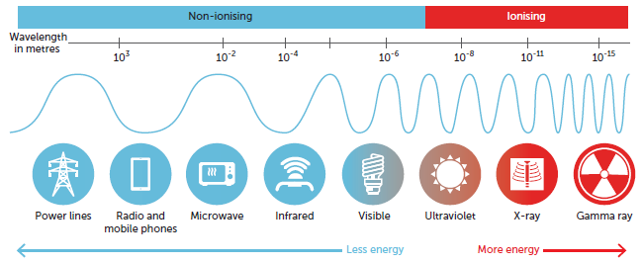
9.1 Mutations
Causes of mutations
Mutations occur without any known cause, but a number of agents are known to increase the rate at which they occur. These are called mutagenic agents or mutagens. Some known mutagens are mustard gas, formaldehyde, sulfur dioxide and some antibiotics. All kinds of ionising radiation, including ultraviolet light, X-rays, cosmic rays, radiation from radioactive waste, and fallout from atomic and nuclear explosions, are also mutagenic. If a woman is treated with large doses of X-rays during the first three months of her pregnancy, the child may be born with intellectual disability, skeletal malformations, or microcephaly.

Slide 6
9.1 Mutations
Types of mutations
When it was recognised that genetic information is contained in the sequence of bases in the DNA, it became possible to understand the chemical nature of gene mutations. A change in the bases could change the amino acid and so could alter a protein. It is possible that a mutation could have no effect at all, or it may alter the protein or prevent it from being produced. Thus, if the DNA of a particular gene is altered, the protein for which it codes may be missing or abnormal. Just one missing or abnormal protein can have an enormous effect on the entire body.
For example, albinism is the result of one missing protein. Albinism is marked by an absence of pigment from the hair, skin and eyes.
Mutations can be classified by a number of different characteristics. It is the sum of these characteristics that determines the overall impact the mutation will have on the individual.

Slide 7
9.1 Mutations
Cause of the mutation
Mutagens in the environment can increase the chance of mutations occurring. These mutations are known as induced mutations. Other mutations occur due to a random error in a biological process such as mitosis or meiosis. These are called spontaneous mutations.
Heritability of the mutation
One way of classifying mutations is by the type of cells where they occur, such as a person’s body cells or reproductive cells. When the body cells, or somatic cells, are involved with a mutation, it is known as a somatic mutation. In this situation, only the individual with the somatic mutation is affected.
If the reproductive cells are affected, the mutation can occur in the gametes and may then be passed on to the next, and subsequent, generations. These are known as germinal or germline mutations. In this case, the individual in whom the mutation occurs is not usually affected, but the affected gametes can be passed on to offspring.

Slide 8
9.1 Mutations
Effect of the mutation
Mutations can be classified is based on their effect.
Missense mutations cause a change in the amino acid, and therefore in the protein produced.
Nonsense mutations change the base sequence to the code to STOP. This means that the synthesis of the protein will stop, and so a shorter protein is produced that is unlikely to be able to fulfil its function.
Neutral mutations cause a change in an amino acid; however, the amino acid is of the same type and does not change the structure of the protein enough to change its function.
Silent mutations do not cause any change in the amino acid, and therefore in the protein produced. This is possible, as most amino acids are coded for by more than one base sequence.

Slide 9
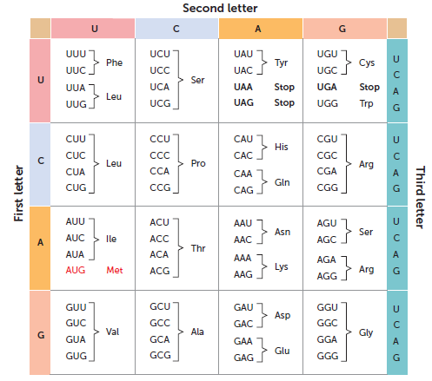
9.1 Mutations
The codons that code for each amino acid. Note that the codon is the sequence of three bases on mRNA. This will be complementary to the base sequence on the DNA molecule

Slide 10
9.1 Mutations
Extent of the mutation
Another characteristic that is used to classify mutations is the amount of DNA affected. This could range from a single base to a whole chromosome. A gene mutation affects only a single gene, while a chromosomal mutation affects a number of genes. It may change the structure of a chromosome or the number of chromosomes. Chromosomal mutations often cause abnormalities so severe that miscarriage often occurs early in the pregnancy.

Slide 11
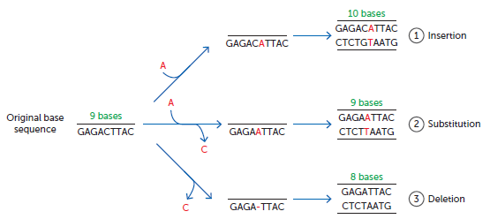
9.1 Mutations
Change in the DNA
Mutations vary in the change in the DNA. Point mutations are due to changes in a single nucleotide; therefore, only one base is changed. These mutations may be due to a nucleotide being:
inserted – a new nucleotide is added to the DNA strand
substituted – an existing nucleotide is replaced with another one, with a different base
deleted – a nucleotide is removed from the DNA strand.

Slide 12
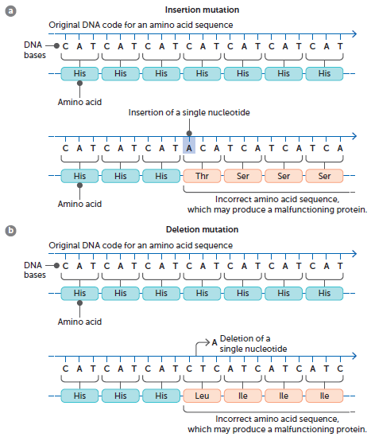
9.1 Mutations
Some mutations will result in a frameshift. A frameshift occurs when bases have been added or removed. This results in the series of three bases that code for an amino acid starting at a different base. Therefore, although the mutation may have only altered a single base, frameshift mutations affect the outcome for all the DNA from that point on.
Frameshift mutations will not occur when three bases are added or deleted. In these instances, the DNA will simply code for one more, or one less, amino acid, but the rest of the amino acids will be the same. Therefore, it would still be a mutation, just not a frameshift mutation.

Slide 13
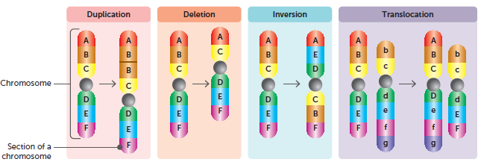
9.1 Mutations
Other mutations affect a larger section of DNA. They may be due to:
duplication (or insertion) – a section of chromosome occurs twice
deletion – a piece of DNA is removed
inversion – breaks occur in a chromosome and the broken piece joins back in, but the wrong way around
translocation – part of a chromosome breaks off and is rejoined to the wrong chromosome

Slide 14
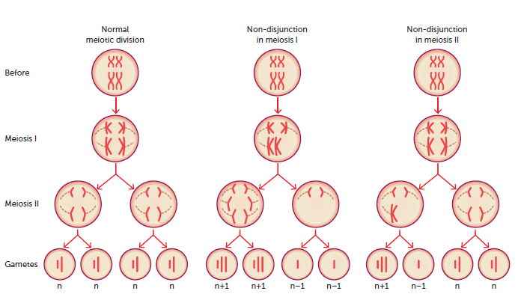
9.1 Mutations
non-disjunction – during meiosis, a chromosome pair does not separate and so one daughter cell has an extra chromosome and one daughter cell has one less than the normal number. These are sometimes referred to not as ‘mutations’, but as aneuploidy – a change in the chromosome number.

Slide 15
9.1 Mutations
Conditions due to mutations
Gene mutations
Duchenne muscular dystrophy may occur through gene mutation. This may arise through a mutation in the mother, which can then be inherited by her sons. The mutation may also occur in a male zygote so that the child develops the disease. This disease results in a wasting of the leg muscles and later the arms, shoulders and chest. Eventually, death occurs due to failure of the respiratory muscles.
Cystic fibrosis is another genetically determined disease caused by a mutation. The mutation occurs in a huge gene on chromosome number 7. The gene has the code for 1480 amino acids that make up a protein that regulates the passage of chloride ions across the cell membrane. Without the correct protein the affected person suffers from a variety of symptoms: salty-tasting skin; persistent coughing, wheezing or pneumonia; and digestive and other problems. The mutant allele is recessive, so a sufferer must inherit it from both parents.

Slide 16
9.1 Mutations
Chromosomal mutations: Trisomy
Trisomy is a result of non-disjunction, failure of one or more chromatids to separate in the second division of meiosis. The eggs or sperm formed when non-disjunction occurs have one chromosome too many, or one chromosome is missing.
A chromosomal mutation that occurs relatively frequently, especially in children of older mothers, is Down syndrome, or trisomy 21, where the child has three of chromosome 21 instead of the normal two. People with Down syndrome have a characteristic facial expression, intellectual disability and weak muscles. They may also suffer from some birth defects such as heart defects or digestive abnormalities.

Slide 17
9.1 Mutations
Many of the symptoms of Down syndrome can also occur when part of an extra copy of chromosome 21 is attached to one of the other chromosomes. This is called partial trisomy.
Patau syndrome is when an extra chromosome 13 produces individuals with intellectual disability, microcephaly, an extra finger on each hand, a cleft palate and/or cleft lip, and malformations of the ears and eyes.
The extra chromosome 13 can come from either the mother’s egg cell or the father’s sperm cell. The features of trisomy 13 result from having this extra chromosome in each of the body’s cells.
Trisomy can also occur with the sex chromosomes. In males, non-disjunction may occur during either the first or the second meiotic division, producing individuals with either an extra X chromosome (XXY) or an extra Y chromosome (XYY). Individuals with trisomy XXY are normal as boys but develop Klinefelter syndrome as adults.

Slide 18
9.1 Mutations
Chromosomal mutations: Monosomy
Monosomy is where an individual is missing a chromosome. If an autosome is completely missing, monosomy usually results in severe malformations and miscarriage. If only part of a chromosome is missing, it is referred to as partial monosomy. Part of the chromosome has two copies, but part has only one copy.
An example of partial monosomy is Cri-du-chat syndrome, a rare genetic disorder due to a missing portion of chromosome 5.
Monosomy can also occur with the sex chromosomes. Individuals with a chromosome set with only one X chromosome (monosomy X) suffer from Turner syndrome.

Slide 19
9.1 Mutations
Lethal recessives
Most gene mutations produce a recessive allele because they prevent the gene from producing a protein that will be able to function in the body. A person could therefore have large numbers of mutations in the genes and be totally unaware of them. If the person reproduces with a partner who has the same recessive mutation, the recessive condition could appear in their offspring.
Some recessive mutations are lethal if they are not masked by a dominant normal allele. These lethal recessives cause the death of the embryo or foetus by a miscarriage or spontaneous abortion, or the early death of the child.
Tay-Sachs disease (TSD) is a disorder of lipid metabolism that is inherited in an autosomal recessive pattern. It is a lethal recessive condition caused by a mutation in the HEXA gene that codes for the enzyme beta-hexosaminidase.

Slide 20
9.2 Migration
Changes in allele frequencies in a gene pool can also be due to gene flow brought about by migration. Gene flow is the movement of genetic material from one population to another. When individuals move between populations, they enable gene flow. This movement is known as migration.
Therefore, if immigrants to a certain country bring alleles that are not already in the population, the frequencies for the alleles of that gene will be altered.
An example of how the distribution of ABO blood groups has been influenced by migration is the change in the frequency of the I^{B} allele across Europe and Asia. The inhabitants of East Asia, the Mongols, have a proportionately higher frequency of the allele I^{B} than those living to their west in Europe. In the 12th and 13th centuries, the Mongols invaded Europe on a number of occasions, spreading their genes. Today, there is a steady decrease in the I^{B} allele from Central Asia to Western Europe.

Slide 21
9.2 Migration
Barriers to gene flow
Populations are often kept apart by barriers that inhibit the amount of interbreeding between them. This isolation leads to separate gene pools forming. Barriers to gene flow can be classified based on their cause.
Geographical barriers include oceans, mountain ranges, large lake systems, deserts and expansive ice sheets. For example, the original inhabitants of Australia were isolated for thousands of years by ocean barriers that formed as sea levels rose.
Sociocultural barriers such as economic status, educational background and social position are barriers to interbreeding. For example, statistics indicate that Australians tend to marry people of similar educational background, and members of particular religious groups favour partners who have the same faith. Religion and language can also be barriers to gene flow. Some religions do not allow marriages outside the religion, and it is unlikely that people who cannot communicate with one another will marry.

Slide 22
9.3 Natural selection
Development of the theory of evolution
Evolution is a gradual change in the characteristics of a species. The theory of evolution through natural selection was put forward independently by Charles Darwin and Alfred Russel Wallace in 1858, but is usually associated with Darwin.
The Galapagos Islands were especially important for his research. Darwin was able to observe the differences and similarities between animals separated by:
geography – those living on the mainland of South America and those on the various islands
time – animals recently extinct and species still alive.
These observations led Darwin to question the commonly held belief that living species had always been exactly the same as they then appeared. He became convinced that species did change.

Slide 23
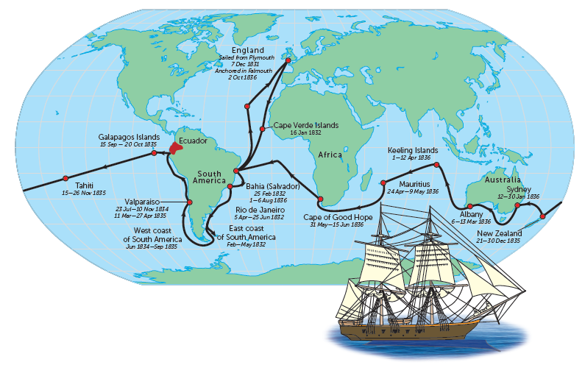
9.3 Natural selection
The route taken by HMS Beagle from December 1831 to October 1836. Darwin’s observations on this journey were crucial to his later ideas on natural selection

Slide 24
9.3 Natural selection
Darwin’s theory of natural selection
Darwin’s theory of natural selection was based on three observations.
Variation: Darwin noted that all members of a species vary. He made no attempt to explain the source of this variation. However, he did point out that these variations were passed on from one generation to the next, with characteristics displayed by the parents being passed on to their offspring.
Birth rate: Inspired by Malthus, Darwin realised that all living organisms reproduce at a rate far greater than that at which their food supply and other resources increase. This would normally result in overcrowding.
Nature’s balance: Darwin observed that, although the birth rate of organisms was very high, each species’ numbers tended to remain at a relatively constant level.

Slide 25
9.3 Natural selection
Darwin realised first that, because of the excessive birth rate and limited resources, there must be a struggle for existence; and, second, because there was a range of variations in any species, those with characteristics best suited to their environment were more likely to survive. This second point became known as survival of the fittest: organisms with favourable characteristics survived, while many of those with unfavourable characteristics died before they had an opportunity to reproduce and pass on the trait.
Survival of the fittest is possible because there is variation within any species. That is, the members of a species differ from one another in their physical characteristics, body functioning and behaviour.
Today, natural selection can be viewed as the selection of those alleles in a population that give an organism a greater survival advantage. The environmental factor acting on the population is known as the selective agent. Those organisms that survive will pass on favourable alleles to their offspring. Gradually, over a period of time, the characteristics of a population change so that it becomes better suited to its environment.

Slide 26
9.3 Natural selection
Alleles and natural selection
The principles of evolution through natural selection can be summarised as follows:
There is variation of characteristics within a species.
More offspring of a species are produced than can possibly survive to maturity.
Because of excessive birth rate and limited resources, there is a struggle for existence or competition for survival.
Individuals with characteristics best suited to the environment have more chance of surviving and reproducing. This is known as survival of the fittest.
Favourable characteristics are passed on to the next generation.
In the gene pool, the proportion of alleles that produce favourable characteristics gradually increases.

Slide 27
9.3 Natural selection
Examples of natural selection
Sickle-cell anaemia
Sickle-cell disease, or sickle-cell anaemia, results when a person is homozygous for a particular recessive allele. We now know that this allele is due to a point mutation in the DNA sequence of the HBB gene. This gene codes for one of the beta-globulin proteins that make up haemoglobin in the red blood cells. The different base sequence means that the amino acid valine is added instead of glutamic acid. This results in a different form of the protein, altering the haemoglobin produced which distorts the shape of the red blood cell.
People who are heterozygotes normally show no ill effects unless oxygen is in short supply. When this occurs, their red blood cells show mild sickling. These individuals are carriers and are said to have sickle-cell trait. Individuals homozygous for the normal dominant allele have blood that shows no signs of the sickling phenomenon.

Slide 28
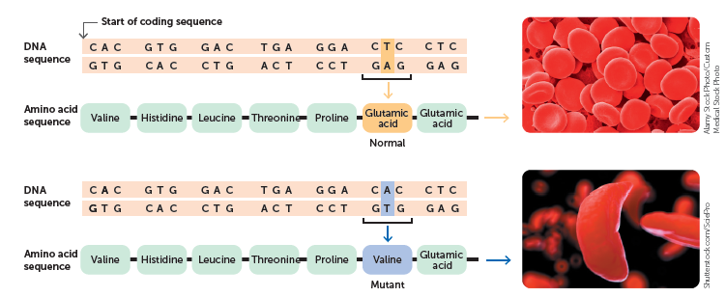
9.3 Natural selection
Alamy Stock Photo/Custom
Medical Stock Photo
Shutterstock.com/SciePro
The point mutation of a substitution of one base pair results in sickle-cell anaemia

Slide 29
9.3 Natural selection
The sickle-shaped red blood cells often die early, resulting in anaemia. They are also inflexible and can become stuck in the blood vessels, causing a blockage.
If a person with sickle-cell anaemia dies before reproducing, the allele that causes the disease is not passed on to the next generation. Therefore, you would expect that over many generations the frequency of the sickle-cell allele would gradually decrease until it was eliminated from the population altogether. On the other hand, if the ratio of mutation of normal alleles to sickle-cell alleles was great enough, it could cancel out the loss of alleles through the death of affected individuals.
However, this is not the case: investigations have shown that the rate of alleles being lost from the population is about 100 times greater than the average rate of mutation at any point along a human chromosome. Some other mechanism must be at work to maintain the sickle-cell allele in the population. The graphs on the next slide show the distribution of malaria and sickle-cell anaemia in the world. You can see that the sickle-cell allele occurs only in areas where malaria is prevalent.

Slide 30
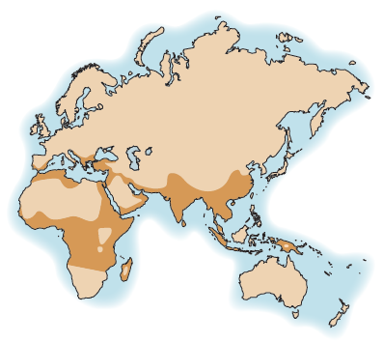
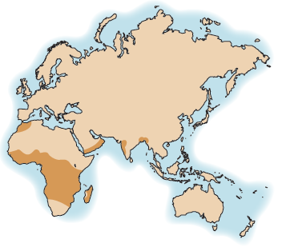
9.3 Natural selection
Distribution of malaria
Distribution of sickle-cell anaemia

Slide 31
9.3 Natural selection
Anthony Allison was one of the first to notice the relationship between sickle-cell anaemia and malaria. He reported that the sickling allele tended to have its highest frequency in areas where the risk from malarial parasites was greatest. He suggested that individuals with one sickle-cell allele were more resistant to malaria than those with normal haemoglobin in their red blood cells.
It is now generally accepted that individuals heterozygous for the sickle-cell allele have a survival advantage in areas where malaria is prevalent.
This example shows how natural selection occurs in human populations. A mutation established a new allele in the population. Having one of these alleles gave individuals living in malarial-prone areas a survival advantage. This is known as a heterozygote advantage. Individuals with two sickle-cell alleles, those with sickle-cell anaemia, usually die. Those who are homozygous for normal haemoglobin are more susceptible to malaria. Therefore, the presence of malaria acted as a selective agent for the sickle-cell allele.

Slide 32
9.3 Natural selection
Tay-Sachs disease
Tay-Sachs disease is a recessive condition found only in individuals who are homozygous recessive. People who are heterozygous have a reduced amount of beta-hexosaminidase. It appears that these individuals have some protection from tuberculosis, an infectious disease that primarily affects the lungs. This means that people who are:
homozygous recessive die before reproducing, due to Tay-Sachs, and therefore do not pass on the recessive allele
heterozygous survive tuberculosis, reproduce and therefore pass on both alleles
homozygous dominant are affected by tuberculosis and may die prior to reproducing.
The heterozygote advantage provided by a heterozygous genotype increases the percentage of the recessive allele in the gene pools in areas affected by tuberculosis.

Slide 33
9.4 Genetic drift
Genetic drift
In any generation there is always the chance that some individuals will be more, or less, likely to pass on their alleles. This produces genetic drift, the random, non-directional change in allele frequency between generations. Genetic drift is not affected by whether an allele is beneficial or harmful; instead, it is purely by chance. Genetic drift occurs in populations of all sizes; however, it is unlikely to have a significant effect in large populations. It can play an important role in evolution in small populations.
Genetic drift is also known as random genetic drift or the Sewall Wright effect.

Slide 34
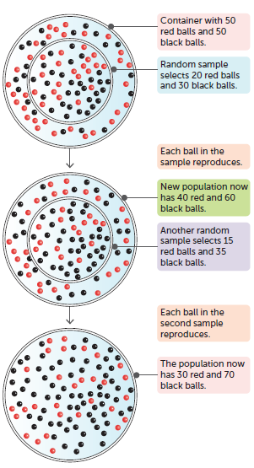
9.4 Genetic drift
A model showing how random sampling of a pair of alleles can, by chance, increase the frequency of one allele and decrease the frequency of the other

Slide 35
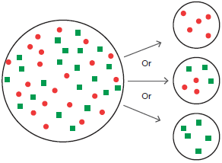
9.4 Genetic drift
Founder effect
An extreme example of genetic drift is the founder effect. This effect occurs when a small group moves away from its homeland to a totally new area and establishes a population, which later expands. Because of its small size, chance can cause the new groups to have:
a different allele frequency from the original population
decreased genetic variation.
This means that the new population may show a frequency of features that are not typical of the original homeland population.
A model illustrating the founder effect. The original population is on the left and three different possible founding populations are on the right. It is possible for the founders to be quite unrepresentative of the original population. The chance selection of the founders will have a marked effect on the gene pool of later populations

Slide 36
9.4 Genetic drift
Bottleneck effect
The bottleneck effect is another extreme example of genetic drift. In this situation, an event such as a natural disaster severely reduces the size of the population. The allele frequency after the disaster may, by chance, be different from before the event. It is important to note that, in the bottleneck effect, the chance of survival is by chance and not due to a specific trait.

Slide 37
9.5 Speciation
All humans belong to the same species. A species is a group of individuals that share many characteristics and are able to interbreed under natural conditions to produce fertile offspring.
Reproductive isolation may lead to the development of separate gene pools. No two environments are exactly the same, so it would be expected that certain alleles would be favoured in one environment more than another. Therefore, over time the allele frequencies of each gene pool will change, depending on which characteristics are favoured for survival. Over many generations, the populations will become less and less alike as they develop characteristics that better suit them to their respective environments.
If two populations are isolated for a very long period of time, and the environmental influences on each are different enough, major changes in the allele frequencies within each population could occur. In such a situation, the members of those populations may become so different that, even if the barriers to reproduction were removed, interbreeding would no longer be possible. If this occurred, the two populations would be regarded as separate species. The process of producing two species in this way is referred to as speciation.

Slide 38
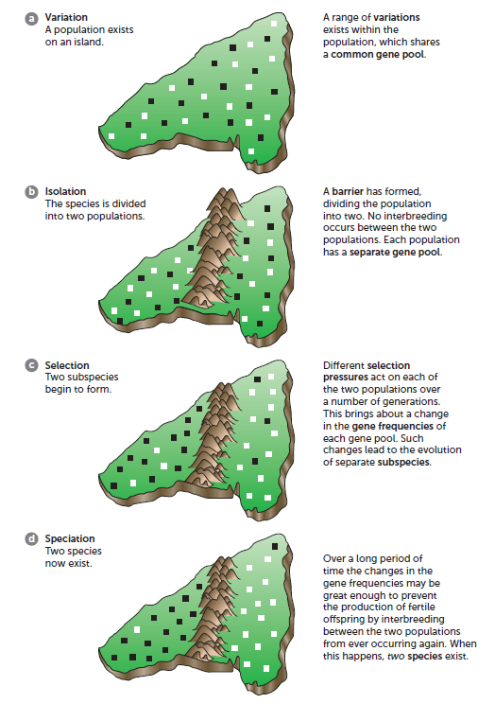
9.5 Speciation

